Slide 1
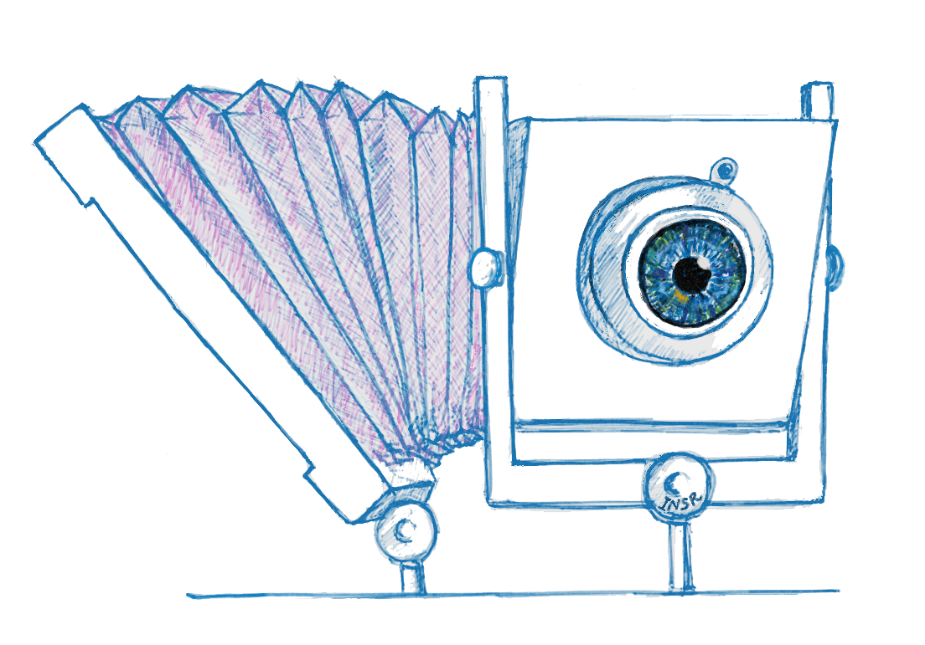
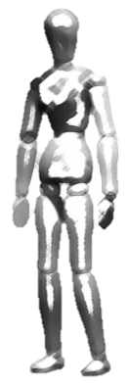
Scheimpflug with Computational Imaging to Extend
the Depth of Field of Iris Recognition Systems
Indranil Sinharoy
Committee:
Dr. Marc P. Christensen
Dr. Delores M. Etter
Dr. Dinesh Rajan
Dr. Panos Papamichalis
Dr. Yunkai Zhou

Slide 2
0.000000000000000000000000000000000000000000000000000000000000000000000001
Unique
Notes:
That’s 71 zeros between the decimal point and the one. That’s the probability that two irises, the colored tissue surrounding the pupils in the eyes, picked at random, will exactly match. That is how staggeringly unique each iris pattern is … but that’s not all.

Slide 3
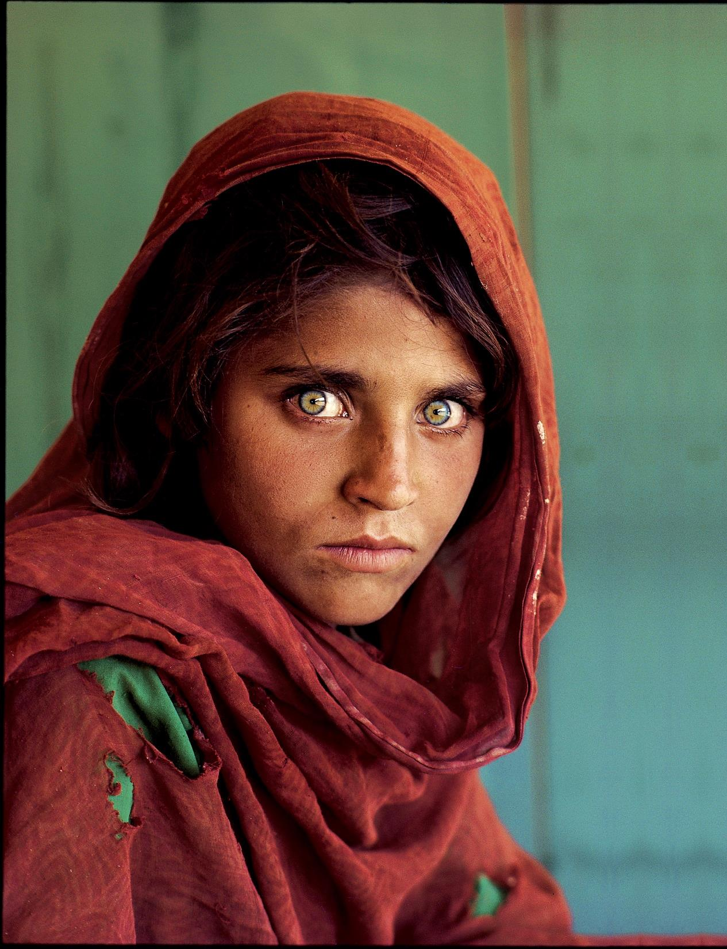
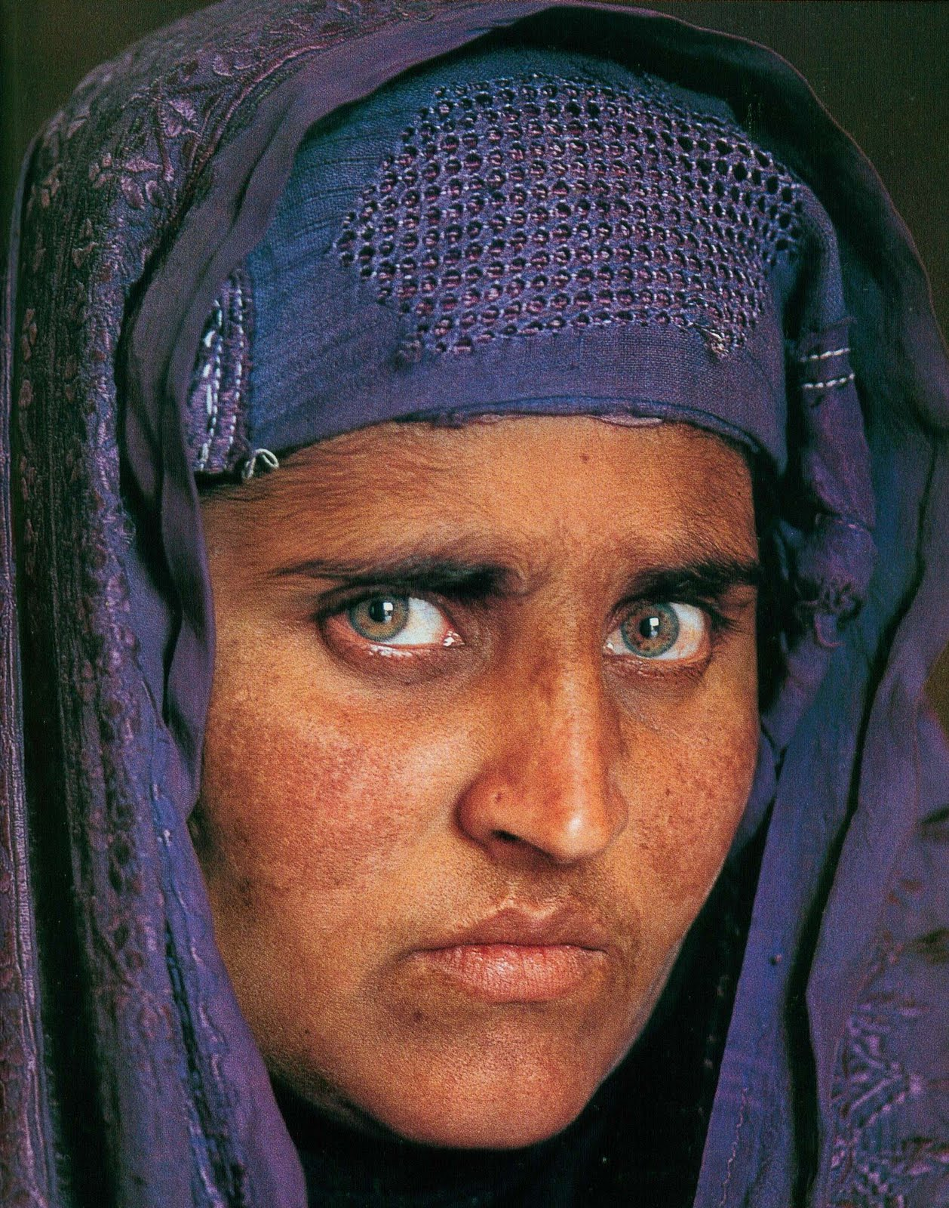
Stable
12 years old, refugee camp, Pakistan, 1984.
Found after 17 years, in 2002.
[Photographs by Steve McCurry, National Geographic.]
Notes:
National Geographic was able to identify and find the real name of the Afghan girl, whose iconic picture became a symbol for the plight of refugees throughout the world, after 17 years using iris recognition technology. That story demonstrates the stability of the iris pattern.
(Her name: Sharbat Gula)

Slide 4
Iris recognition is an

Slide 5
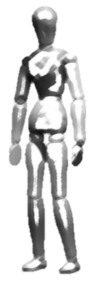
Demonstration of capture volume improvement using AFS in the laboratory
L
W
H
Standoff distance
Notes:
Explain the capture volume … how our approach suits our goals …. We are interested in increasing the axial capture volume …

Slide 6
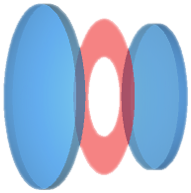
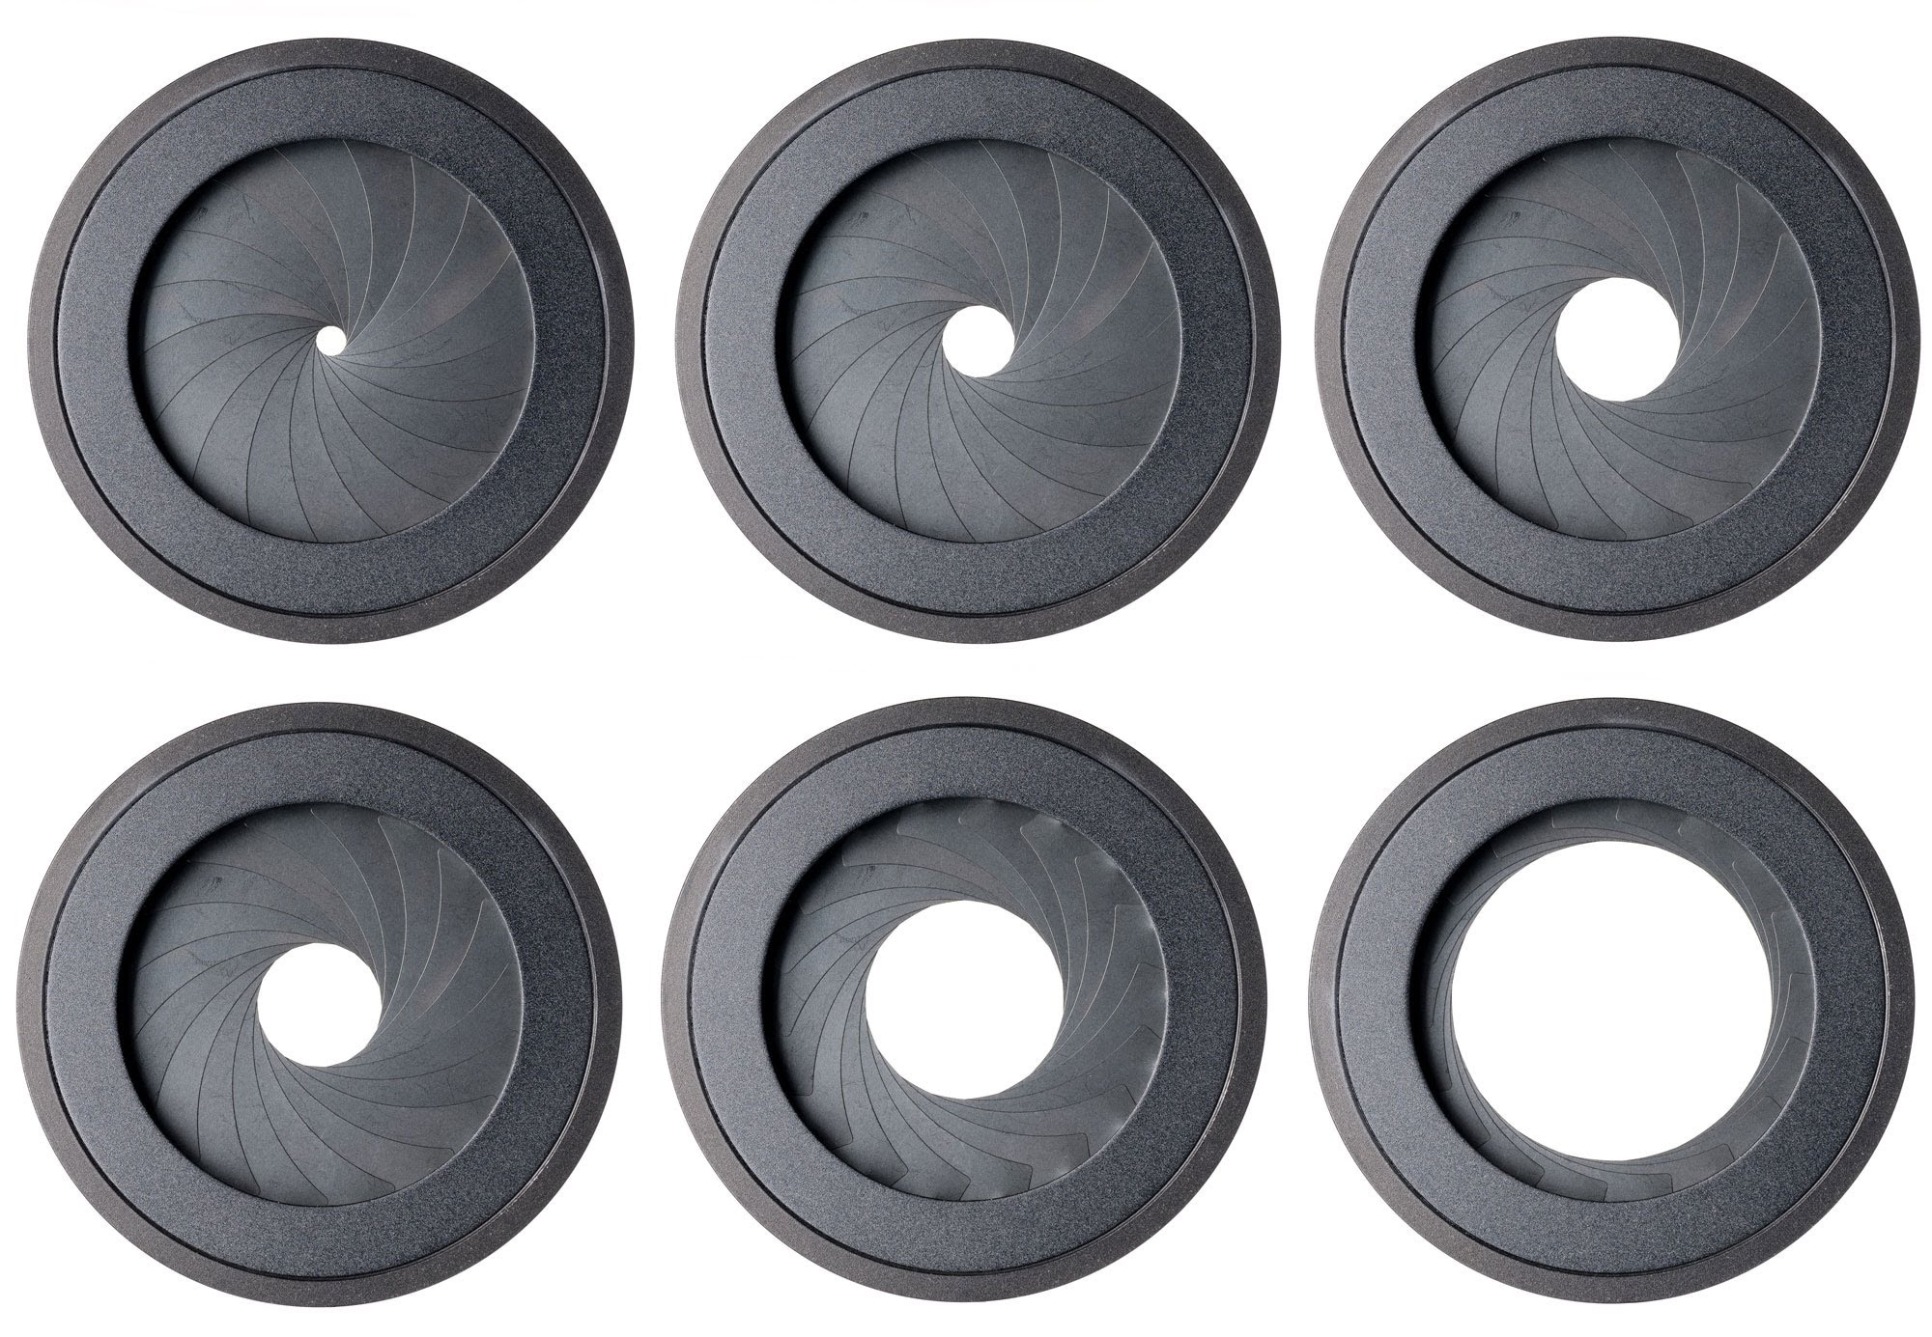
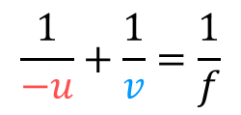

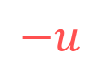
The depth of field (DOF) is the limited range of distances in the scene that appear sharp in the image
Lens elements
Aperture stop
Lens elements
Image plane
$$−u$$
$$v$$
DOF
$$\frac{1}{−u}+\frac{1}{v}=\frac{1}{f}$$
Plane of sharp focus (PoSF)
Gaussian formula:
Shallow DOF
Large DOF
F/5.6
F/8
F/11
F/16
F/22
Notes:
The Gaussian lens equation implies that only one plane in the object space can be in focus. I need to be very clear about mentioning that the F/# are ratios, the value depends on the diameter

Slide 7
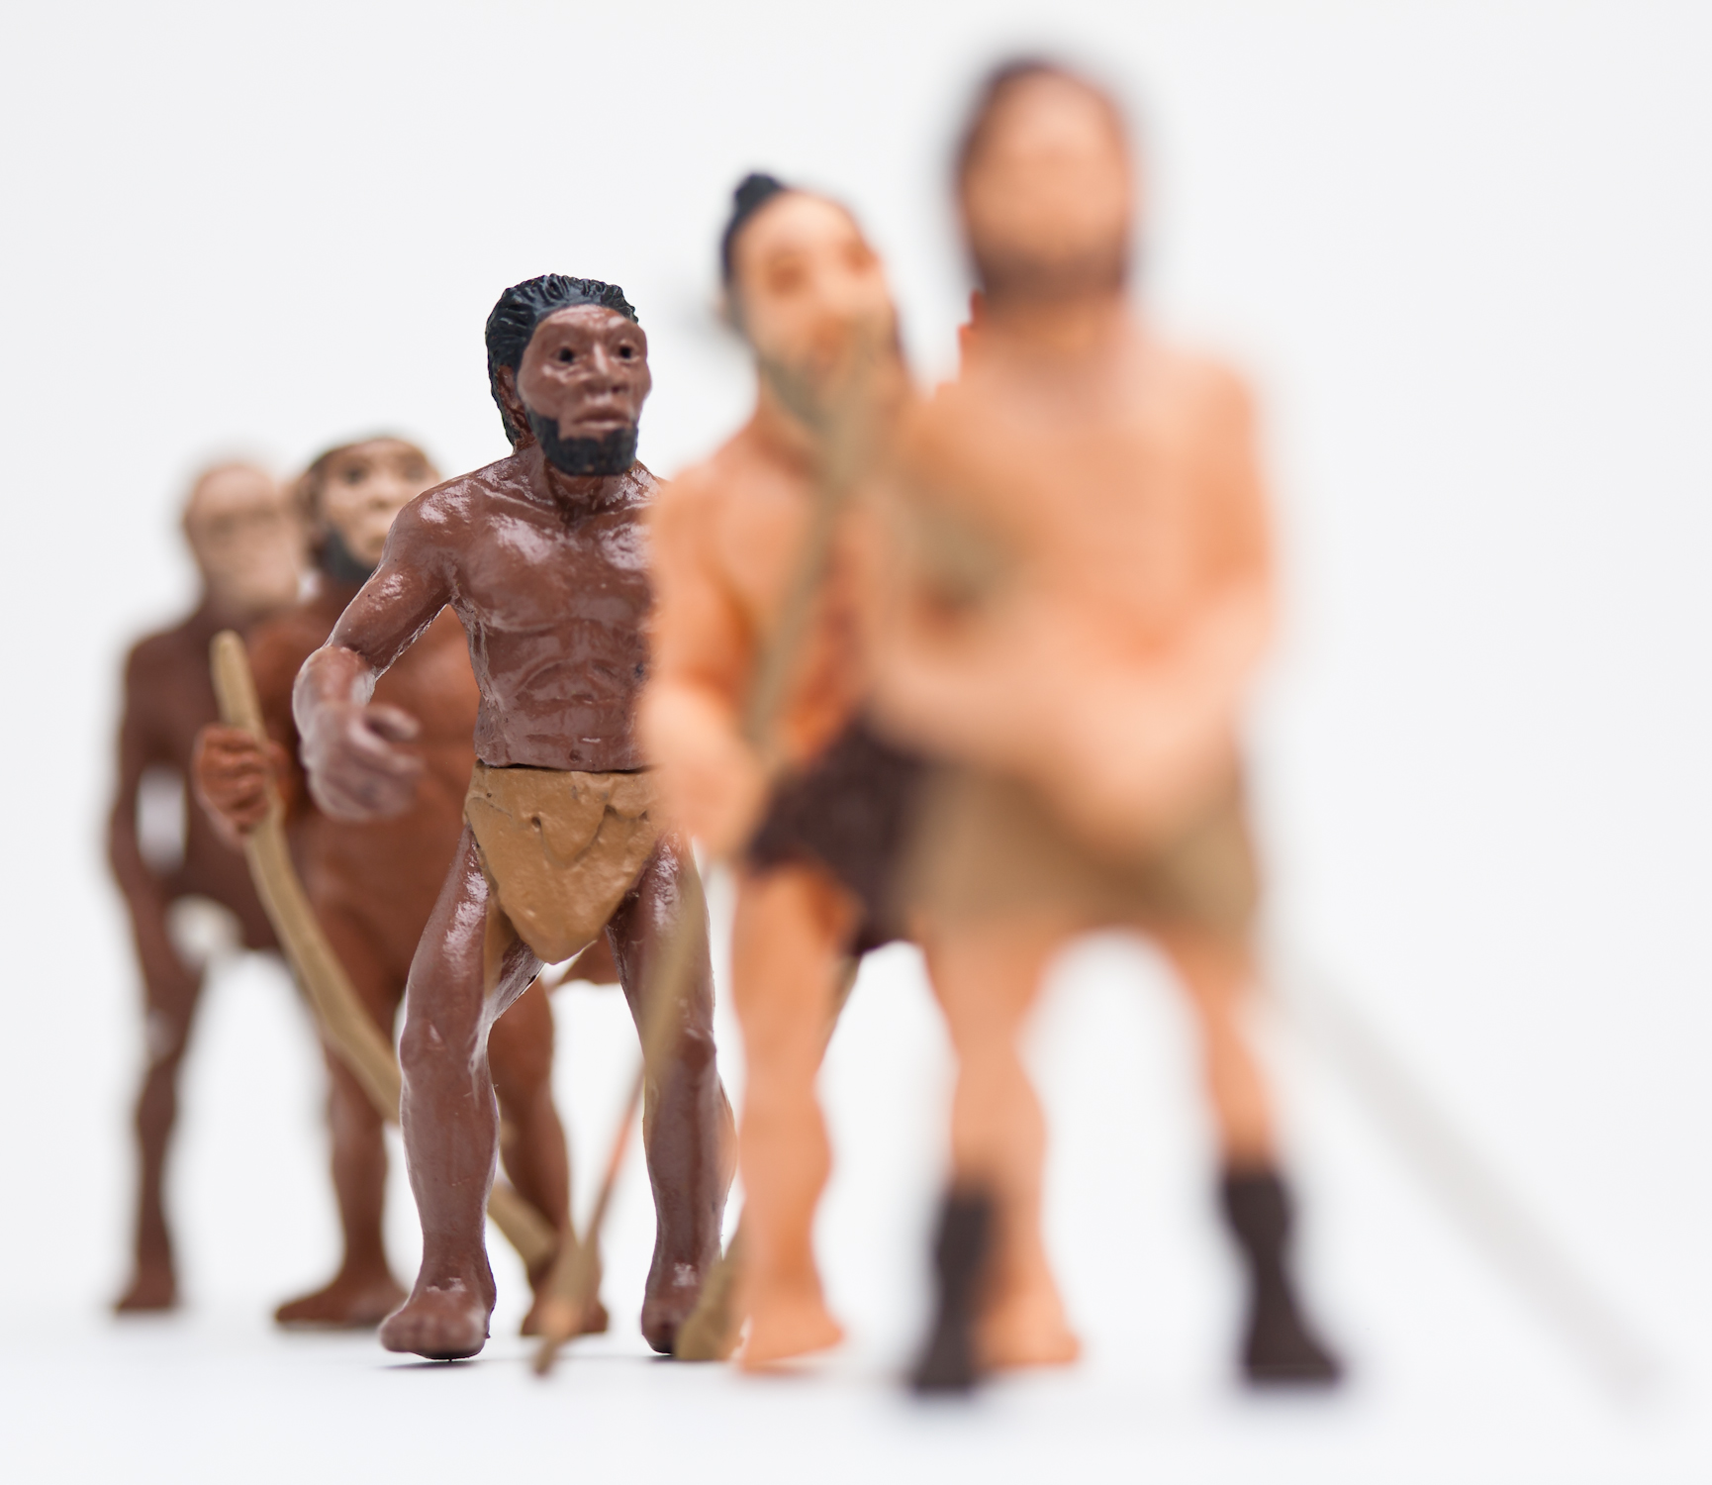
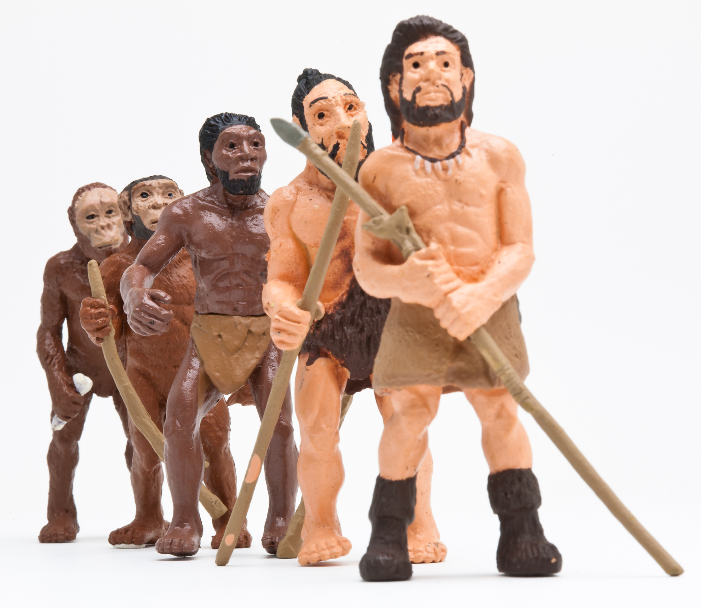
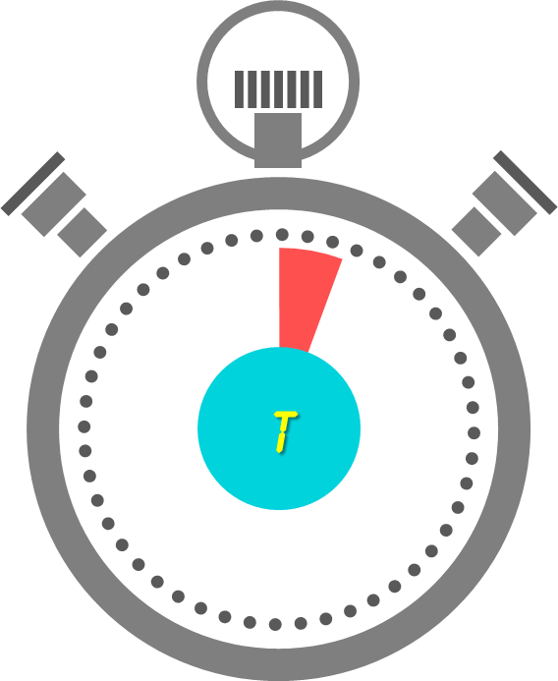

In traditional cameras the DOF is usually controlled by the aperture
Shallow DOF, aperture: F/2.8
Large DOF, aperture: F/32
Notes:
This is an example.
….
But if we can get a large DOF by using a smaller aperture, then why don’t we use a small aperture for extending the DOF of iris recognition systems?
There are a number of reasons, and here is one:
[[The clocks appear]]
It took over two orders of magnitude more time to capture the image on the right. While that’s probably OK for inanimate beings, (alt: while that is just fine for those whose time has run out ..) it is …..

Slide 8
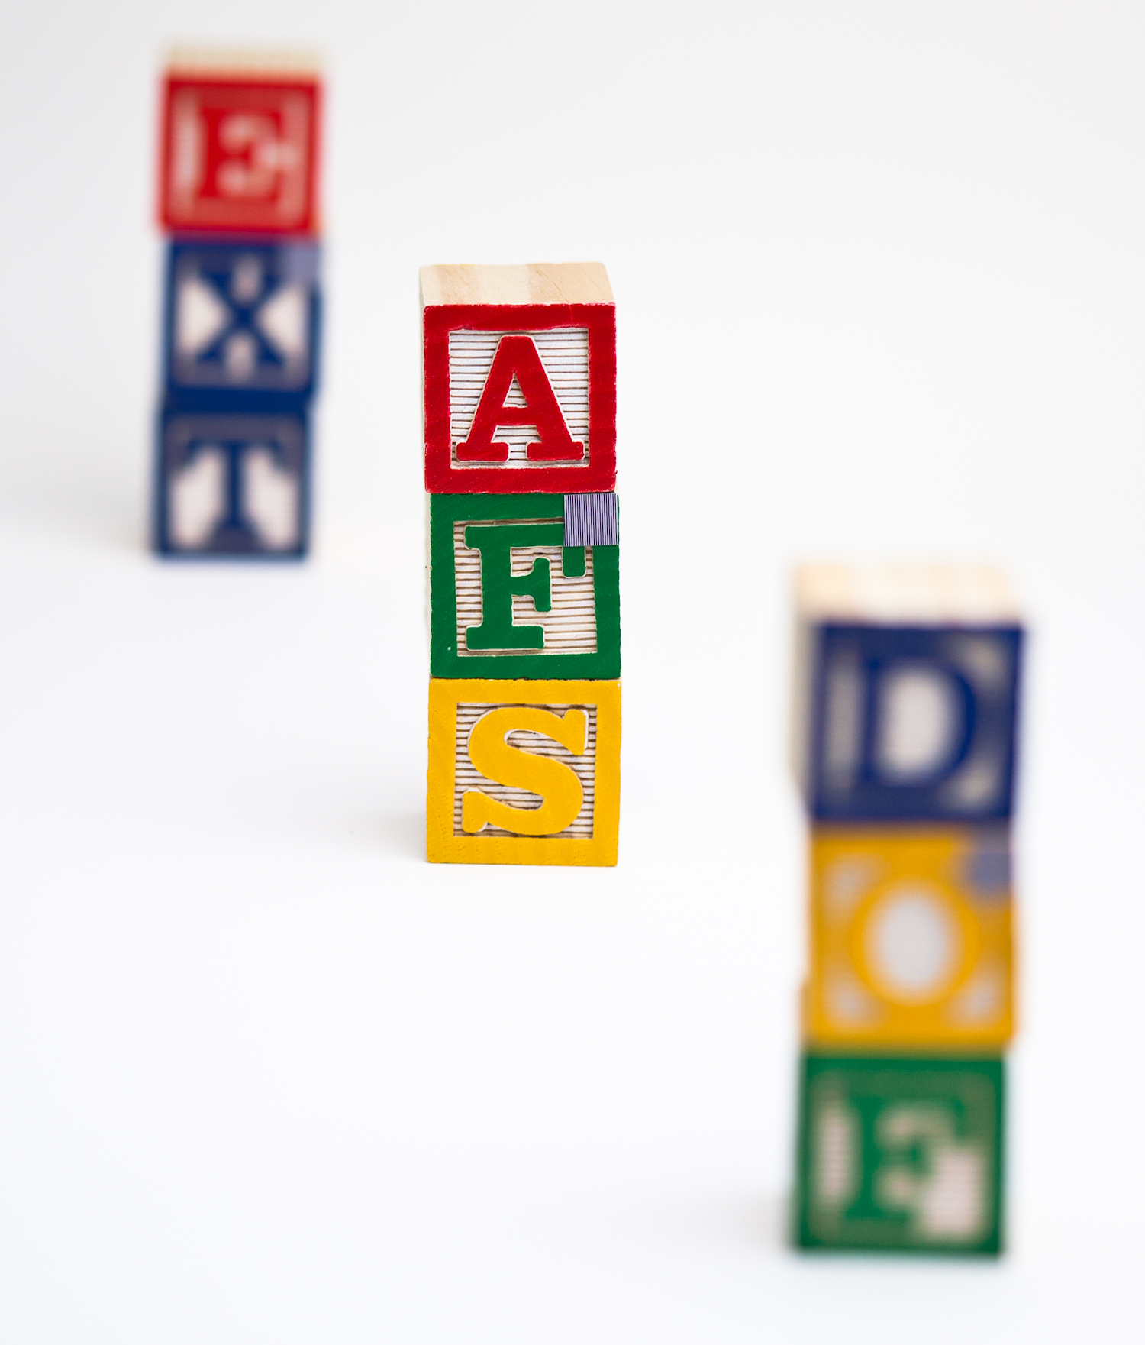




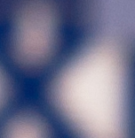
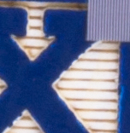
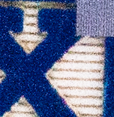
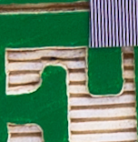
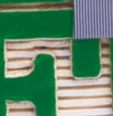
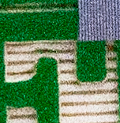

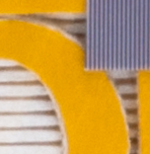
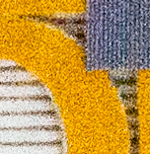
It is impossible to get high resolution, large DOF & high SNR simultaneously
in traditional imaging
Notes:
….therefore,

Slide 9
Notes:
When we started looking into this problem, the first thing we did, as most researchers would do is look at the existing solutions.
Talk in brief about the existing solutions.
Talk about their disadvantages

Slide 10
Notes:
[Blank slide?]
After thinking about various ways to approach the problem, for example, using light field cameras, … we decided to invest on … scheimpflug princ…. Or using a scheimpflug camera.

Slide 11
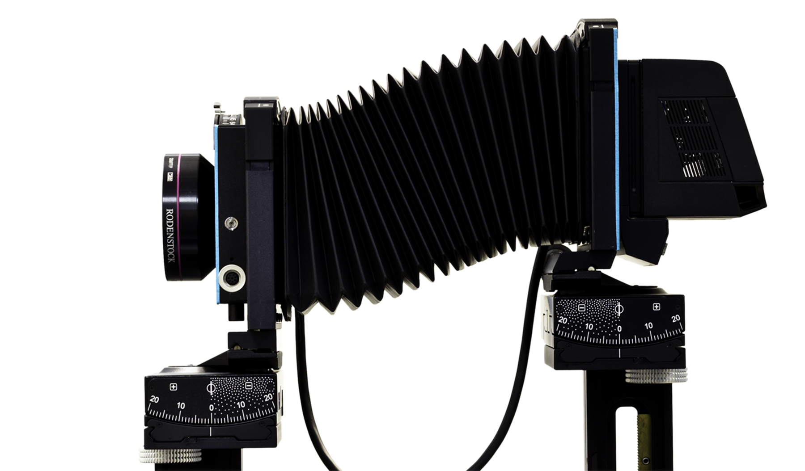
The lens & sensor in a Scheimpflug camera can rotate about independent pivots

Slide 12
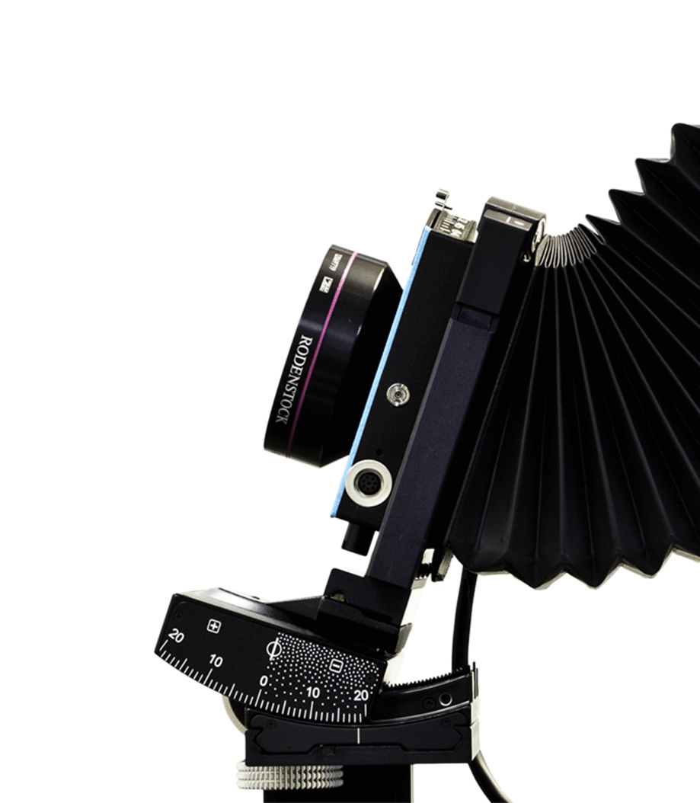
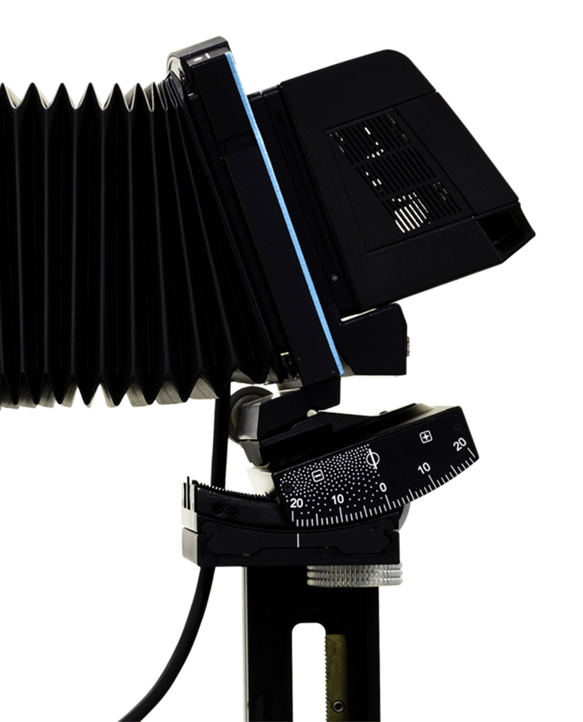
The lens & sensor in a Scheimpflug camera can rotate about independent pivots

Slide 13

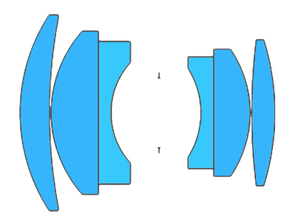
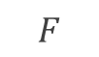
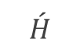

Scheimpflug principle: Rotating the lens or the sensor also rotates the plane of sharp focus
$$F$$
$$\acute{H}$$
$$H$$
Optical axis
Sensor
Plane of sharp focus (PoSF)
Depth of field (DOF)

Slide 14

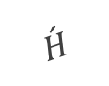

Scheimpflug principle: Rotating the lens or the sensor also rotates the plane of sharp focus
$$F$$
$$\acute{H}$$
$$H$$
Sensor
Depth of field (DOF)
Optical axis
Plane of sharp focus (PoSF)

Slide 15
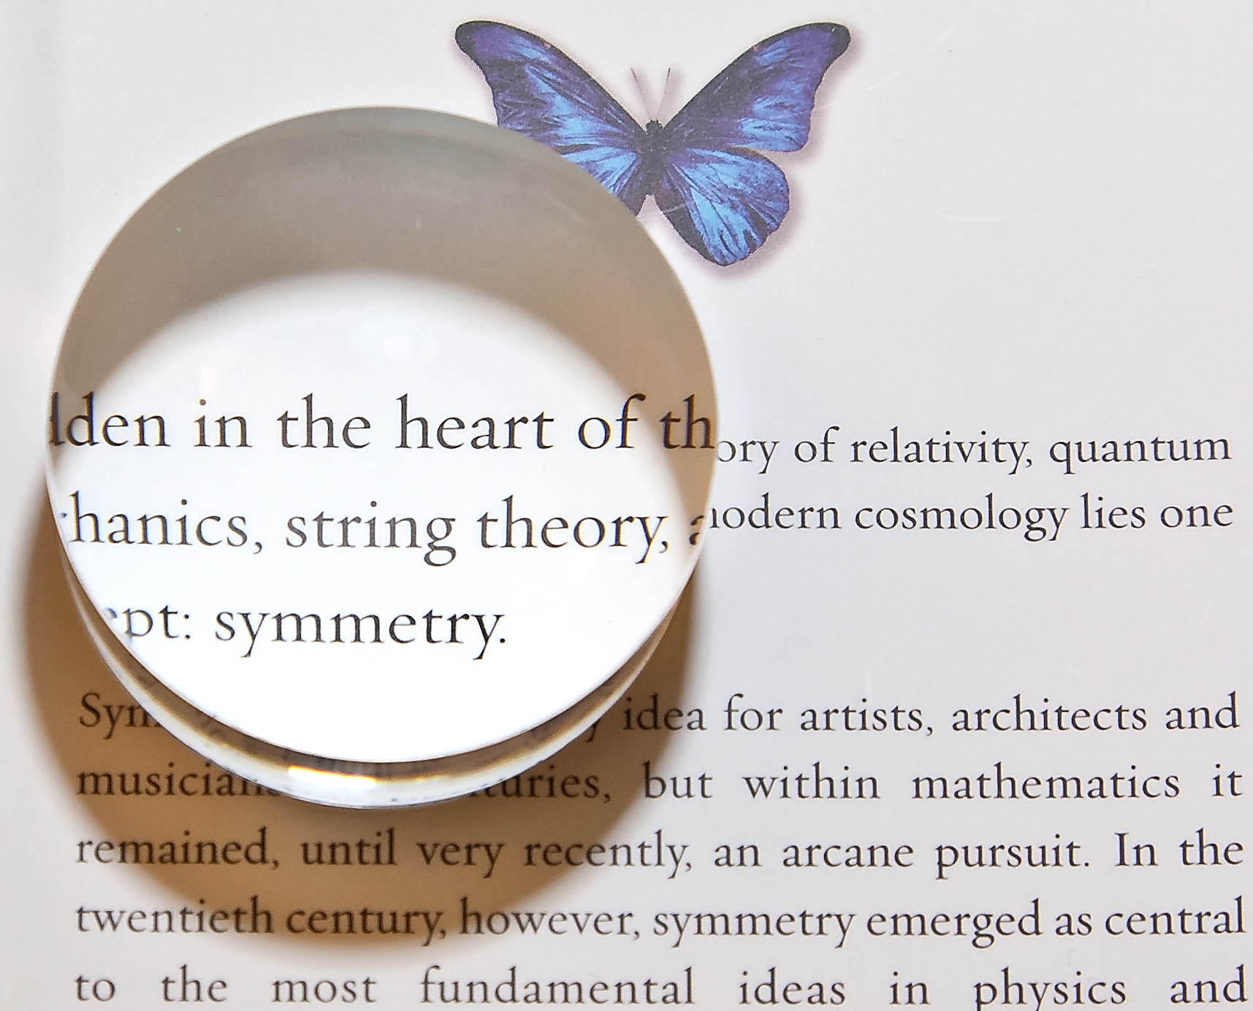
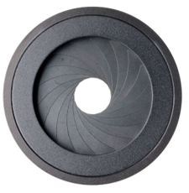
The “entrance pupil” is the image of the stop formed by the front lens elements
and the “exit pupil” is the image of the stop formed by the rear lens elements

